Slide 1



Airbnb Recruiting - New User Bookings Where will a new guest book their first travel experience?
By Sumita Soundararajan Foundations of Data Science Workshop by Springboard Mentored by Anirban Ghosh, Nokia

Slide 2
Agenda
Problem
Dataset
Data Exploration
Data Pre-processing
Model Selection
Result
Challenge
Recommendation

Slide 3
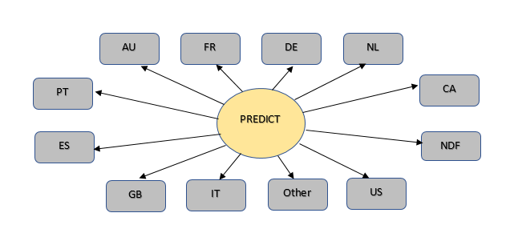
Problem
Airbnb – New User booking challenge from Kaggle competition
Predict the destination country of a new user’s first booking
12 possible classes for destination with NDF meaning “No booking”

Slide 4
Dataset
Training and Test user data
Training set: 213,451 users --Jan 2010 to Jun 2014
Test set: 62,096 users--July 2014 to Sep 2014
User information:
User id
Date account created
Timestamp of first activity
Date of first booking
Age
Gender
Language
Web browser
Channel through which the user accessed Airbnb
Country destination
Session data
10,567,737 rows -- 2014
User web browser session:
User id
Action
Action_type
Action_detail
Device_type
Secs_elapsed

Slide 5
Country Destination
12 classes with NDF meaning “No booking”
58% of users have not made a booking.
70% of bookings done in US
Unbalanced Classes

Slide 6
Gender
Female – 29.6%
Male – 25.5%
Unknown – 44.9%
No difference in booking based on gender

Slide 7
Data Pre-processing
Observe all distributions
Identify all NA and handle them
Identify all missing values or ‘blanks’ and replace them
Feature Engineering
Base Data Feature Extraction
Replace extreme values (2% & 98%) using Winsorization
Remove predictors with zero and near-zero variance
Remove highly correlated predictors
Final base feature dataset with 64 predictors

Slide 8
Model Selection
Supervised Learning method
Multi-class classification
Build 66 level binary classifiers based on destination
Two machine learning algorithms chosen
Logistic Regression
best for binary classification problems
Decision Trees
can handle numerical and categorical data
can handle multiple classes
can handle class imbalance
can handle missing data

Slide 9
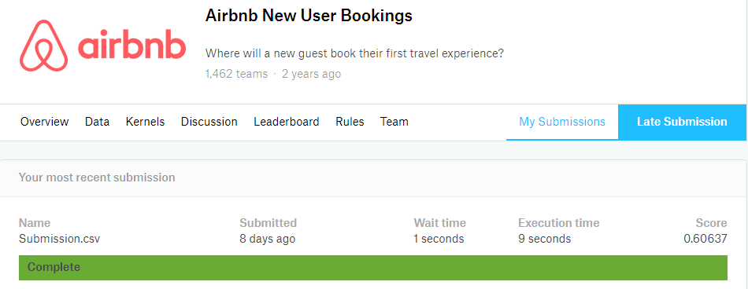
Result
5 predictions on the country of their first booking for every user
Most probable country_destination predicted first
Submission File with predictions from the Decision Tree algorithm generated a score of 0.606 on the Kaggle website.

Slide 10
Challenge
Time constraint
Could improve the prediction result with
Better knowledge on different machine learning algorithms
Better data preparation
Utilized user information for feature extraction
Minimized number of features used in the final model
Evaluated more models

Slide 11
Recommendation to Airbnb
Improve demographic data to differentiate country destinations.
Include more validation checks on Age and Gender, Make them mandatory for users to book a reservation.
Collect meaningful browser session activity for training users since this data was most helpful for predictions
The sessions data was available only for newer users created during 2014 whereas users in the Training set dated back to 2010.
Make the actions, action type, details in sessions dataset more meaningful since it was difficult to understand what they meant.

Slide 12
Thank you!

